Slide 1
Urban Infrastructure Lecture 1
TODAY:
Course Introduction and Overview
Urban Systems through an Infrastructure Lens: Core Concepts
Sao Paulo, Brazil
Notes:
Welcome
Do class introductions here
Ask for the following:
Degree
Undergraduate degree
What you hope to learn from this course

Slide 2
Urban Infrastructure
The role of infrastructure in shaping the contemporary city
Infrastructure types and delivery
Actors responsible for planning, delivery and maintenance
How infrastructure shapes built form
Operational interface between planning and infrastructure
Notes:
Main aim of the course
Objectives that feed into that
Go through them one by one in the next couple of slides
The use of case studies

Slide 3
Course Outline
i:
THE EVOLUTION OF THE RELATIONSHIP BETWEEN INFRASTRUCTURE, URBAN PLANNING AND CITIES
Cato Manor, Durban

Slide 4
Course Outline
I:
THE EVOLUTION OF THE RELATIONSHIP BETWEEN INFRASTRUCTURE, URBAN PLANNING AND CITIES
II:
THE ‘PIPES’ – UNDERSTANDING MATERIAL ELEMENTS
Barcelona, Spain
Notes:
The ‘pipes’
Actual nuts and bolts of these infrastructures –
Not just networked infrastructures but also;
Housing
And social facilities
Here need some help:
Roger Behrens on utilities and transportation
I’ll talk about social infrastructure and housing
OUTCOME: operational elements and be able to talk sensibly to an engineer BUT also challenge the standards that inform them; look at the variations critically

Slide 5
Course Outline
I:
THE EVOLUTION OF THE RELATIONSHIP BETWEEN INFRASTRUCTURE, URBAN PLANNING AND CITIES
II:
THE ‘PIPES’ – UNDERSTANDING MATERIAL ELEMENTS
III.
ACTORS AND AGENCY
Khayalitcha, Cape Town
Notes:
Then we take a 180 degree turn
And I say to you
This is not just about nuts and bolts
It is not just about the pipes
These pipes are managed and owned by various actors
They have impact
They carry agency
And influence the ways through which our cities function
But also how we experience them
Focus heavily on the Splintering Urbanism thesis Stephen Graham and Simon Marvin
And critique thereof
AND sustainability issues
Which also starts to address the question
What about when infrastructures fail…
Japan recently is a good example; many others – electricity crisis in South Africa

Slide 6
Course Outline
I:
THE EVOLUTION OF THE RELATIONSHIP BETWEEN INFRASTRUCTURE, URBAN PLANNING AND CITIES
II:
THE ‘PIPES’ – UNDERSTANDING MATERIAL ELEMENTS
III.
ACTORS AND AGENCY
IV:
WHEN INFRASTRUCTURE FAILS
Lagos, Nigeria
Notes:
What happens when infrastructures fail?
The invisible becomes visible
Three reasons we use a case:
experiential learning
cross cutting issues
individual agency and livelihoods
Spending a lot of time on this – reading and preparation
Answer key questions

Slide 7
Parts | Learning Objectives | % / Course | Cases
Historical Evolution | Understanding how infrastructure has shaped cities historically | 26 % | Paris and London Global South cases developed by students
Material Elements | The ‘pipes’ – grasp of shape and distribution of infrastructural elements | 30 % | Secondary cases; includes ecosystems services
Actors, Agency and Socio-technical Networks | Knowledge of actors, relations between them and in particular, the role of the planner | 24 % | Students develop cases of community-based practice
When infrastructure fails | Insights into causes and the dynamics that emerge from infrastructure failure | 20 % | Lagos
Notes:
Note:
The use of cases. Some developed by students.

Slide 8
Urban Systems
MACRO
Regional relationships
Networks
MESO
Geographic Entity
Defined Institutional Entity
MICRO
Elementary Units
Internal networks
Notes:
How cities and regions function is informed by networks (systems theory)
What drives the growth of a city?
Economic imperatives
Technological changes
In-migration
Agglomeration
The strange notion of the ‘one-hour city’
London:
17th Century: radius of 3 to 4 km
1830 from 6 to 8 km
1900; 20 km
2000; 70 – 80 km from the centre
Technological innovation:
1829: horse omnibus
1836: steam railway
1863: steam metropolitan
1905: electric metropolitan
Obviously the growth of the city is influenced by what happens ‘outside’ its boundaries

Slide 9
The City
MACRO
Regional relationships
Networks
Internal networks
Elementary Units
MICRO
Defined Institutional Entity
Geographic Entity
MESO
Public Infrastructure
Private Investment
Notion of the Capital Web
The role of the planner
Intra-urban relations
Traditional models on urban functioning

Slide 10
MACRO
Regional relationships
Networks
Internal networks
Elementary Units
MICRO
Defined Institutional Entity
Geographic Entity
MESO
City as functional entity
Administrative boundaries
Specific Geographic Entity
Function
Institutional Entity

Slide 11
MACRO
Regional relationships
Networks
Internal networks
Elementary Units
MICRO
Defined Institutional Entity
Geographic Entity
MESO
Inter-urban relationships
Regional role
Relationship to the region
Function on the region
Relations with other cities
Notes:
Quite useful to think about how all of this is influenced by;
Political economy
Topography
Culture
History
Demography (for example European cities versus African cities and the demands for each)
Urban systems evolve
not static

Slide 12
Relationships between cities
INFRASTRUCTURE
Transport
Bulk
ECONOMIC
Trade
Financial
GOVERNANCE
Livelihoods / Social
Institutional
ECOLOGICAL
Bio-diversity
Natural Systems
Visible and invisible networks
Systems of cities
Networks defined by nature of those relationships
informed by political control
Economic System
Underpinned by technological innovation
Notes:
Visible and invisible networks
The visible relates to the pipes, roads and other physical qualities
The invisible relate to capital and information flows for example
This results in a system of cities
Go through each of these networks...
What defines these networks?
Moved from political control (the church, the monarchy, the state) to economic actors…underpinned by technological innovation….
HAS THIS CHANGED? Well it must have!
Some would argue yes! Castells and Sassen….

Slide 13
GLOBAL CITIES
The impact of Information and Communication technologies (ICT)
Economic restructuring
Separation between research and development, management, production and distribution
Growth of the service sector
Sassen
Castells – Network Society
Endless City Exhibition, London
Notes:
Couple of things to remember:
These systems are not static
they are not delimited
should be seen as a pliable membrane
that is more or less permeable
according to the size and function of the cities within the system
HOW THEN; has this changed with information technology; how have economic systems changed and how has this affected relations between cities?
IS THERE A HIERARCHY?
Castells
Spaces of flows versus space of places
Sassen
World City networks

Slide 14
ORDINARY CITIES
”….Africa, like everywhere else, has its heres, its elsewheres, and its interstices.”
(Mbembe and Nuttall 2004: 351)
Kitwe, Zambia
Notes:
RESPONSE FROM JENNY ROBINSON; McFarlane and Ward
Something from Graham and Thrift?

Slide 15
ELECTROPOLIS
Electrical networks connect the heating, cooling, and energizing of urban life
through
infrastructure to both far-off energy reserves
and
Global circuits of pollution and global warming
Pompeii, Italy
Notes:
Mediators between nature and the production of the city

Slide 16
HYDROPOLIS
Huge water systems sate the city’s insatiable thirst,
Their waste water systems and sewerage parallels
Removing human and organic wastes from the urban scene
Rome, Italy

Slide 17
CYBERCITY
New telecommunications systems provide a universe of mobile connectivity and digital connections
Where we are always ‘on’
Lamontville, Durban

Slide 18
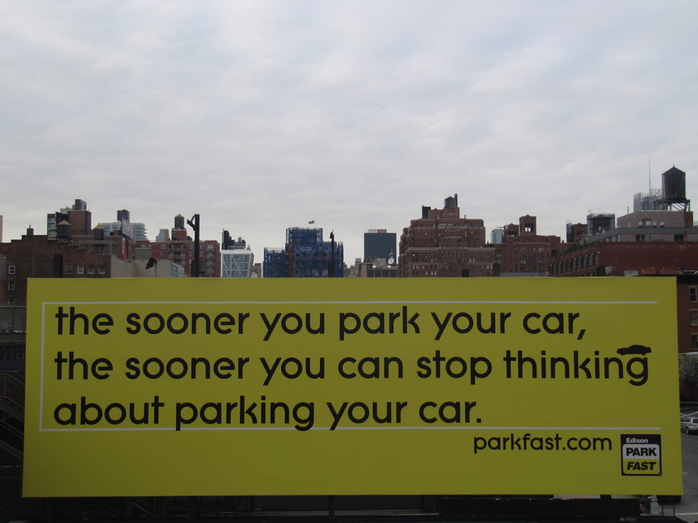
AUTOCITY
Highways, airlines, train, and road complexes support the complex and multiscaled flows of commuters, tourists, refugees, goods and services that connect places and cities
Linking the city with the hinterland and the periphery
New York City

Slide 19
Inter-relationships
Interconnectedness
One relies on the other
Invisible?
Value-free?
Until Infrastructures fail
Accra, Ghana
Notes:
None of these infrastructural networks operate in isolation from others.
There is an interdependency that could be very bad news for a city
Which leads us to the question: ‘what happens when infrastructure fails?’ – theme in this course and the look at Lagos
By and large we think of these systems as invisible, as value free and as objectified entities that are under our control
UNTIL they fail
Then they become VERY visible!
Multiple infrastructures rely on each other:
EXAMPLE OF PAYING FOR FUEL WITH CREDIT CARD….

Slide 20
Embodied infrastructures
Sensors
Ubiquitous computing
Infrastructure as an extension of the body
Thinking differently about the spatial relationships between user and technology
Infrastructure that mediates personal experience
Accra, Ghana
Notes:
Infrastructure is becoming increasingly embodied (Dourish)

Slide 21
Rethinking the line between urban experience and infrastructure
When infrastructure fails
Embodied infrastructure
From flow to metabolism
From ordinary to extraordinary – crisis and infrastructure
Lagos, Nigeria
Notes:
Realize that they are intrinsic to urban life; rethink and re-theorise contemporary urban life

Slide 22
Design Nirvana
Bruce Mau:
“…the secret ambition of design is to become invisible, to be taken up into a culture, absorbed into the background…
The highest order of success in design is to achieve ubiquity, to become banal…”
Kisumu, Kenya
Notes:
Infrastructure as an anthropological phenomenon
Black-boxing a technology
Good usable infrastructural systems disappear
almost by definition
The less sexy infrastructures fade into the background
They become visible when they break down
When the system fails; when it is no longer working
You SEE the components of the system!! – this is the link to urban systems
The contradictions come to the foreground; who owns it, who runs it, who has vested interest in it; who does it serve, who does it not serve…

Slide 23
Infrastructure as Precarious Achievement
The dynamic achievement of a functioning energy, communications, water or transport network requires constant effort to maintain the functioning system
These are socio-technical systems underpinned by institutional relationships informing livelihoods
Nairobi, Kenya

Slide 24
Between Nature, Culture, Society, Technology and Politics: The Infrastructural Turn
Infrastructure as Assemblage
Cyborg Cities
Political Infrastructures
Nairobi, Kenya
Notes:
Three dimensions to this
(Graham)

Slide 25
Infrastructure as Assemblage
Socio-technical networks
Dynamic
Constantly being negotiated
Much more than a collection of technical ‘things’
Nairobi, Kenya
Notes:
“ that it is best to consider urban infrastructures as complex assemblages that brings all manner of human, non-human, and natural agents into a multitude of continuous liaisons across geographical space”
The grid is always a precarious achievement ready to untangle at a moment’s notice through a myriad of possible causes

Slide 26
Cyborg Cities
Blending the social and the technical
‘technological networks…are mediators through which the perpetual process of transformation of Nature into City takes place’
The social production of urban natures
Technologies do not operate autonomously
Nairobi, Kenya
Notes:
Cybernetic organism
Both artificial and organic
Blending between natural and urban systems – technology mediates that

Slide 27
Political Infrastructures
Who does infrastructure serve?
Who suffers when there is breakdown?
“a key starting point here is that the construction of spaces of mobility and flow for some always involves the construction of barriers for others”
kinetic elites
privatisation and liberalisation of infrastructure
Kibera, Kenya

Slide 28
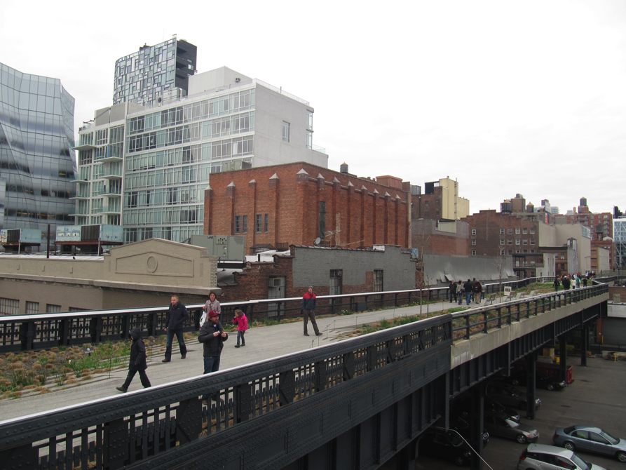
Cities and Infrastructure Networks
Modern urbanism as a socio-technical process
The ‘High Line’, New York City
Notes:
What are the bits?
Wires
Ducts
Tunnels
Streets and Highways
Conduits
The flow, movement and exchange of information is mediated by infrastructure
Mediators between nature and the production of the city (USE PHOTO FROM HIGH LINE)
The city as the staging post in these perpetual flows
Hotbeds of demand and exchange
Sites of global circulation and production
Articulate movement of workers, migrants and tourists
Through their endless technological agency, these systems help transform the natural into the cultural, the social and the urban

Slide 29
SO…
What role has infrastructure played in the ongoing evolution of urban systems and how has technology evolved - what has the implication for cities been?
How do these technologies work?
Who drives them, who benefits, who is excluded; what is the relationship between human and technical agency?
What do people do when infrastructure fails and what does this say about the contemporary city?

